Slide 1
輿情平台功能流程
數據研究發展中心
2018年10月

Slide 2
報告概要
文本挖掘
長文摘要
情緒分析
詞雲
聲量
企業關聯

Slide 3
Text Summarization
長文摘要

Slide 4
長文摘要類型
Text Summarization
長文摘要
Input Type
輸入類型
Purpose
目的
Output Type
輸出類型
Single Document
單文件
Generic
通用
Extractive
萃取方法
Multi-Document
多文件
Domain-Specific
特定領域
Abstractive
抽象方法
Query-Based
基於查詢
Notes:
Generic – model makes no assumptions about the domain or content of the text to be summarized
Domain-specific – where the model uses domain-specific knowledge to form a more accurate summary (e.g., medical papers, finance articles, weather news)
Query-based – contains only information which are queried by the user (e.g., snippets produced by search engine)

Slide 5
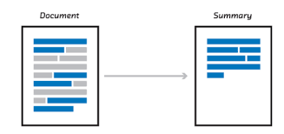
長文摘要流程
Data Collection
資料取得
Data Cleaning
資料清理
Data pre-processing
數據處理
取得需要分析的資料
自己爬文(e.g., 社群網站)
購買數據集(e.g., Bloomberg dataset)
檢查和標準化資料
排除重複和不符的輸入
刪除標點,停止詞,等等
詞法分析(i.e., 分詞)
數據選擇/縮小
抽取特徵,並轉換成電腦可以讀取和分析的格式
Text Summarization
自動擷取長文摘要
Model Evaluation
分類模型評測
Implement a Model
應用選擇的模型
人類評測
自動文摘評分
ROUGE
Precision, Recall, Accuracy, F-Score
Topic Identification
主題辦認
Interpretation
文意理解
Summary Generation
創建摘要
Notes:
Data Pre-Processing – Includes cleaning, instance selection (dataset reduction), normalization, transformation, feature extraction and selection
Data Mining -> Data Cleaning -> Data Integration -> Data Normalization -> Data Aggregation -> Instance Selection -> Feature Engineering (Selection and Construction) -> Modeling -> Evaluation -> Visualization/Summarization

Slide 6
長文摘要流程
Data Collection
資料取得
Data Cleaning
資料清理
Data Pre-processing
數據處理
輸入
判斷和選擇需要的資料
使用爬蟲爬文
利用購買的數據集
輸出
收集好的資料
輸入
收集好的資料
檢查,合併,和標準化收集的資料
排除重複,缺失,和不符的輸入
刪除標點,停止詞,等等
輸出
清理好的資料
輸入
詞法分析(i.e., 分詞)
數據選擇/縮小
數據normalization
抽取特徵,並轉換成電腦可以讀取和分析的格式
輸出
處理和準備好的數據, 可以用來做分析
Notes:
Data Mining -> Data Cleaning -> Data Integration -> Data Normalization -> Data Aggregation -> Instance Selection -> Feature Engineering (Selection and Construction) -> Modeling -> Evaluation -> Visualization/Summarization
Data Pre-Processing – Includes cleaning, instance selection (dataset reduction), normalization, transformation, feature extraction and selection

Slide 7
長文摘要流程
Implement a Model
應用選擇的模型
Model Evaluation
分類模型評測
Text Summarization
自動擷取長文摘要
輸入
處理過的數據集
選擇和訓練好的模型
(訓練數據集)
輸出
初期長文摘要
輸入
模型輸出的結果
人類的評測
自動文摘評分
ROUGE評測
Precision, Recall, Accuracy, F-Score
輸出
模型評測的分數
輸入
評測和調整好的模型
視覺化工具
輸出
長文摘要
Notes:
Data Pre-Processing – Includes cleaning, instance selection (dataset reduction), normalization, transformation, feature extraction and selection
Data Mining -> Data Cleaning -> Data Integration -> Data Normalization -> Data Aggregation -> Instance Selection -> Feature Engineering (Selection and Construction) -> Modeling -> Evaluation -> Visualization/Summarization

Slide 8
長文摘要演算法
Extractive¹
萃取方法
Abstractive
抽象方法
Frequency Based
詞數
Structure Based
結構體
Tree based
Template based
Ontology based
Lead and body based
Rule based
Feature Based
特徵
Machine Learning
機器學習
Semantic Based
語義
Multi-Document
多文件
Cluster Based
聚類
Multimodal semantic model
Information item based
Semantic graph based
Graph Based
圖論
¹Kumar, Y.J., O.S. Goh, H. Basiron, N.H. Choon and P.C. Suppiah (2016). A Review on Automatic Text Summarization Approaches.
Notes:
https://thescipub.com/PDF/jcssp.2016.178.190.pdf
https://github.com/miso-belica/sumy
Template based – Uses templates acquired from human-authored summaries (using a clustering and multi-sentence fusion algorithm) to segment a document based on topics, and then extract important phrases from it. Then, a system selects templates by referring to the relationship between human-authored summaries and their sources and fills the templates with the phrases to create summaries

Slide 9
Sentiment Analysis
情緒分析

Slide 10
情緒分析類型
Sentiment Analysis
情緒分析
SA Scope
情緒分析類型
Analysis Type
分析類型
Document Level
文件
Generic
通用
Sentence Level
句子
Domain-Specific
特定領域
Feature Level
特徵
Notes:
Machine Learning Approach: requires training data for supervised learning
Lexicon-based Approach: does not require training data

Slide 11
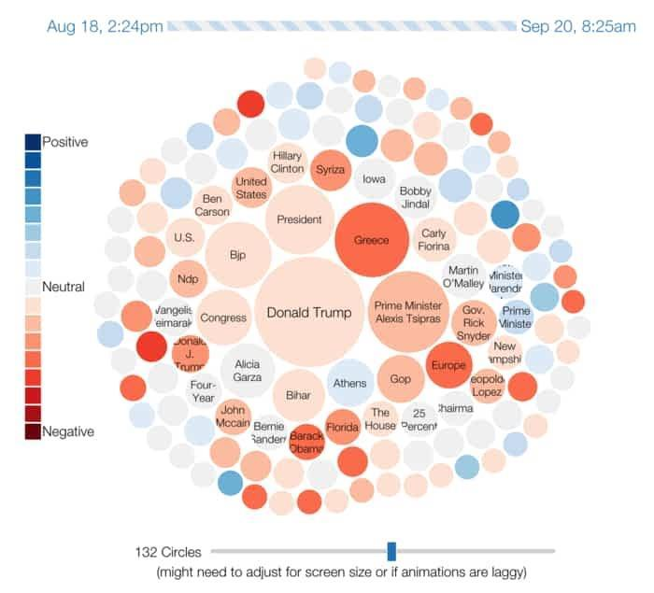
情緒分析流程
Train Classifier
訓練分類器
Data Collection
資料取得
Implement Model
應用模型/分類器
選擇演算法來創造一個模型或分類器
獲取訓練數據進行分類器訓練(語料庫)
把數據切成三組(training,validation,test)
Data Cleaning
資料清理
Data pre-processing
數據處理
Sentiment Analysis
情緒分析
Model Evaluation
分類模型評測
把數據分類成好評,中立評,或負評
Test組的分數
交叉驗證(cross-validation)
Accuracy, Precision, Recall, F-Score, Confusion Matrix
Visualize Results
情緒視覺化
用圖表(e.g., 趨勢圖,詞運)代表情緒的分類
訓練階段
應用階段
Notes:
Data Pre-Processing – Includes cleaning, instance selection (dataset reduction), normalization, transformation, feature extraction and selection
訓練 vs. 應用

Slide 12
情緒分析流程
Train Classifier
訓練分類器
Model Evaluation
分類模型評測
Data Collection
資料取得
輸入
選擇演算法來創造一個模型或分類器
獲取訓練數據進行分類器訓練(語料庫)
把數據切成三組(training,validation,test)
輸出
訓練好的分類器
輸入
分類器/Test組的分數
交叉驗證(cross-validation)
Accuracy, Precision, Recall, F-Score, Confusion Matrix分數
輸出
分類器的評分
持續訓練和評分如果不及格
Data Cleaning
資料清理
Data pre-processing
數據處理
Notes:
Data Mining -> Data Cleaning -> Data Integration -> Data Normalization -> Data Aggregation -> Instance Selection -> Feature Engineering (Selection and Construction) -> Modeling -> Evaluation -> Visualization/Summarization
Data Pre-Processing – Includes cleaning, instance selection (dataset reduction), normalization, transformation, feature extraction and selection

Slide 13
情緒分析流程
Implement Model
應用模型/分類器
Sentiment Analysis
情緒分析
Visualize Results
情緒視覺化
輸入
訓練好的分類器
輸出
訓練好的分類器
輸入
整理好的資料
輸出
把數據分類成好評,中立評,或負評
輸入
視覺化工具(e.g., Wordcloud, Gephi)
分類成好評,中立評,或負評的資料
輸出
情緒視覺化
Notes:
Data Mining -> Data Cleaning -> Data Integration -> Data Normalization -> Data Aggregation -> Instance Selection -> Feature Engineering (Selection and Construction) -> Modeling -> Evaluation -> Visualization/Summarization
Data Pre-Processing – Includes cleaning, instance selection (dataset reduction), normalization, transformation, feature extraction and selection

Slide 14
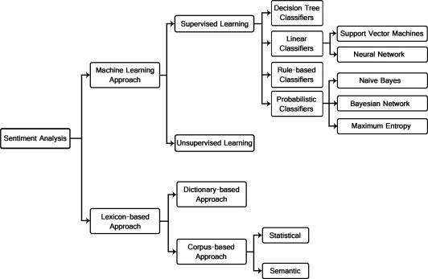
情緒分析演算法
Bing, L. (2012). Sentiment Analysis and Opinion Mining.
Notes:
Machine Learning Approach: requires training data for supervised learning
Lexicon-based Approach: does not require training data

Slide 16
Methods演算法

Slide 17
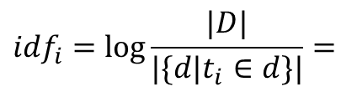
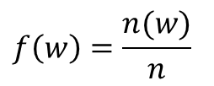


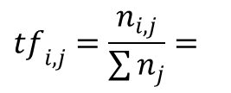
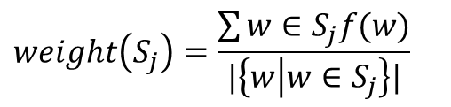

Text Summarization 長文摘要
Frequency Based
詞數
Word Probability
單詞概率
TF-IDF
用句子的weight判定最適合做摘要的句子(SumBasic)²
判定一個詞對於一個在文集裡的文件多重要³
$$f\left(w\right)=\frac{n(w)}{n}$$
$${tf}_{i,j}=\frac{n_{i,j}}{\sum{n_{j}}}=$$
$$\frac{Number of times word i appears in document j}{Total number of terms in document j}$$
$$weight\left(S_{j}\right)=\frac{\sum{w∈S_{j}f(w)}}{|\left\{w | w∈S_{j}\right\}|}$$
$${idf}_{i}=\log{\frac{|D|}{|\{d|t_{i}∈d\}|}}=$$
$$\frac{Total number of documents in corpora}{Total number of documents with term i in it}$$
$$tf−{idf}_{i}={tf}_{i,j}×{idf}_{j}$$
²Nenkova, A. and L. Vanderwende (2005). The Impact of Frequency on Summarization.
³Jurafsky, D. and J.H. Martin (2009). Speech and Language Processing.
Notes:
Word probability is the most basic of the summarization methods, but is often used as a baseline for evaluation and comparison.
SumBasic is one of the most used packages for this purpose.
TF-IDF is also a frequency based method, and is commonly used in conjunction with other summarization methods (e.g. clustering, machine learning).
TF-IDF essentially weighs the frequency in a word appears in a document in proportion to how often it appears in a corpus

Slide 18
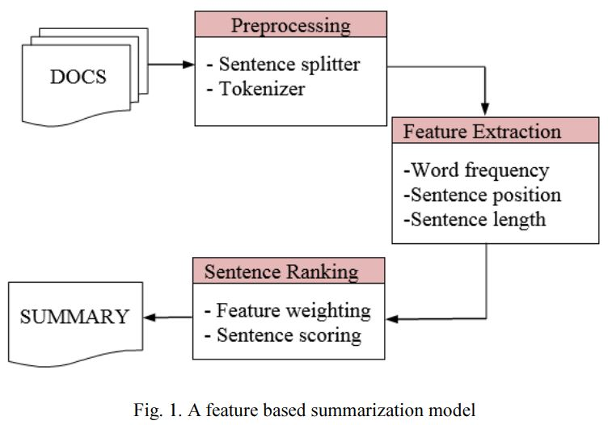
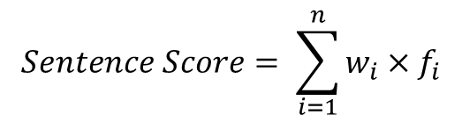
Text Summarization 長文摘要
Feature Based⁴
特徵
Title/Headline Word 題目/標題詞
含題目或標題的句子
Sentence Position 句子位置
段落/文件第一/最後一個句子
Sentence Length 句子長度
句子不能太短或太長
Term Weight 單詞加權
常出現的單詞
Proper Noun 專有名詞
人名,地名,組織,節日
(Cue Words) 提示詞
總之,總而來說
$$Sentence Score= \sum_{i=1}^{n}{w_{i}×f_{i}}$$
⁴Gupta, V. and G.S. Lehal (2010). A Survey of Text Summarization Techniques.

Slide 19
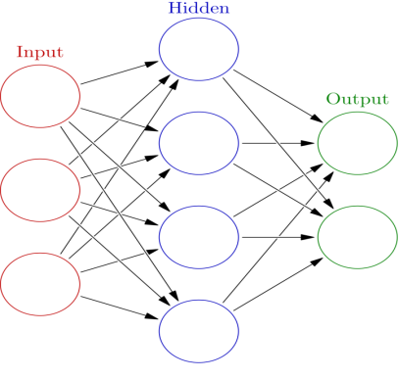
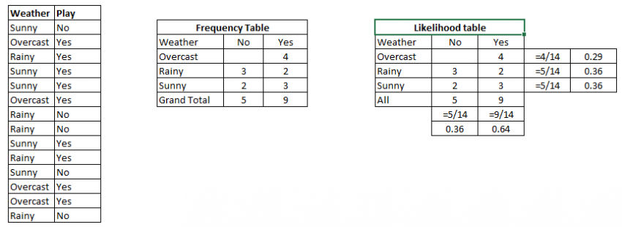
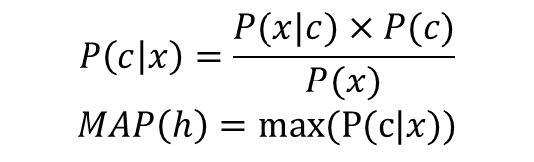
Text Summarization 長文摘要
Machine Learning
機器學習
Naïve Bayes⁵
單純貝氏分類器
Neural Network⁶
人工神經網路
根據數據選擇最佳的假設
Gaussian, Multinomial, 或Bernoulli模型
E.g. NetSum⁷
$$P\left(c | x\right)=\frac{P(x|c)×P(c)}{P(x)}$$
$$MAP\left(h\right)=max(P(c|x))$$
⁵Neto, J.L., A.A. Freitas and C.A.A. Kaestner (2002). Automatic Text Summarization using a Machine Learning Approach.
⁶Jurafsky, D. and J.H. Martin. (2009). Speech and Language Processing.
⁷Svore, K.M., L. Vanderwende and C.J. Burges (2007) Enhancing Single-document Summarization by Combining RankNet and Third-party Sources.
Notes:
Machine Learning requires training data in order to learn how to summarize text
$$P\left(Yes | Sunny\right)=\frac{P\left(Sunny | Yes\right)×P(Yes)}{P(Sunny)}=\frac{0.33×0.64}{0.36}=0.60$$
MAP(h) = maximum probable hypotheis, AKA the hypothesis with the highest probability
Neurons – comprised of weighted input signals (one for each input and one for the inherent neuron bias), and an activation signal that produces an output signal
Activation function – a simple mapping of summed weighted input to the output of the neuron. It is called an activiation function because it governs the threshold at which the neuron is activated and strength of the output signal (e.g. threshold at 0.5, if summed input was above it, neuron would output a value of 1, if not then 0)
Stochastic Gradient Descent – the classical and still preferred training algorithm, where one row of data is exposed to the network at a time as input. The network processes the input upward activating neurons as it goes to finally produce an output value, called a forward pass (also the type of pass that is used after the network is trained in order to make predictions on new data). The output of the network is then compared to the expected output and an error is calculated. The error is then propagated back through the network, one layer a time, and the weights are updated according to the amount that they contributed to the error, called the backpropgation algorithm.
Online learning vs batch learning – updating weights from the errors calculated for each training example vs. saving up all errors across all training examples and updating at the end
Amount that weights are updated is controlled by a configuration parameter called the learning rate (AKA step size)

Slide 20
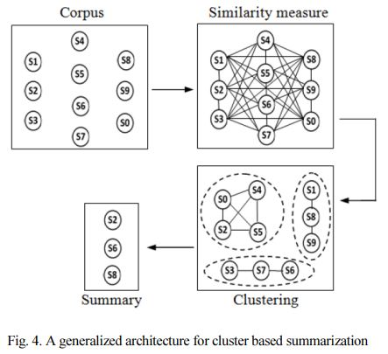
Text Summarization 長文摘要
Cluster Based
分群
使用相似計算把類似的句子聚類成同一個分組 (clustering)
不同的分組代表不同的話題,然後從每個分組得到高分的句子抽出來做摘要
高分數的句子會最類似分組的中心(centroid)⁸
⁸Radev, D.R., H. Jing, M. Syys and D. Tam (2004). Centroid-based summarization of multiple documents.
Notes:
Centroids are the top-ranking TF-IDF that represents the cluster – can also use other clustering algorithms such as k-means
(Cosine similarity used to identify the sentences in each cluster that are most similar to the centroid)
Cluster based methods have been successful in its task to represent diversity and reduce redundancy within multiple articles. Although these can be considered the advantage of using clustering methods, as far as multi document is concerned, a summary cannot be meaningful enough if the relevance of a sentence is judged merely based on the clusters. This is because in clustering based method, eventually sentences are ranked according to its similarity with cluster centroid which simply represents frequent occurring terms.

Slide 21
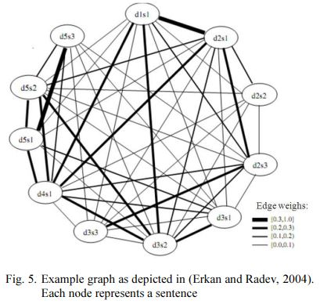
Text Summarization 長文摘要
Graph Based
圖論
用圖模擬句子之間的相似性
圖(graph)代表要做摘要的文件
節點(vertex)代表句子
線段(edge)等於句子之間的weight
創造圖之後,再選擇最重要的句子(越多線段)
e.g., LexRank⁹, TextRank¹⁰演算法
⁹Erkan, G. and D.R. Radev (2004). LexRank: Graph-based Lexical Centrality as Salience in Text Summarization.
¹⁰Mihalcea, R. and P. Tarau (2004). TextRank: Bringing Order into Texts.
Notes:
This approach differs from the cluster based approach where sentences are ranked based on its closeness to cluster centroid.
However, this approach depends heavily on sentence similarity to generate graph, without “understanding” the relationship between the sentences.
LexRank – TF-IDF cosine similarity measure TF-IDF餘弦相似性
TextRank – similar measure to LexRank based on the number of words two sentences have in common (normalized/標準化 by the sentences’ length, weight represented as a percentage of words in common)
TextRank:
Separate the text into sentences based on a trained model
Build a sparse matrix of words and the count it appears in each sentence
Normalize each word with tf-idf
Construct the similarity matrix between sentences
Use Pagerank to score the sentences in graph

Slide 22
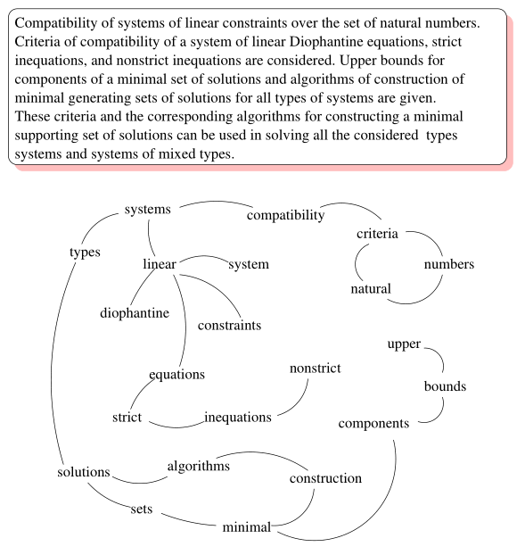
Text Summarization 長文摘要
Graph Based
圖論
Notes:
This approach differs from the cluster based approach where sentences are ranked based on its closeness to cluster centroid.
However, this approach depends heavily on sentence similarity to generate graph, without “understanding” the relationship between the sentences.
LexRank – TF-IDF cosine similarity measure TF-IDF餘弦相似性
TextRank – similar measure to LexRank based on the number of words two sentences have in common (normalized/標準化 by the sentences’ length, weight represented as a percentage of words in common)
TextRank:
Separate the text into sentences based on a trained model
Build a sparse matrix of words and the count it appears in each sentence
Normalize each word with tf-idf
Construct the similarity matrix between sentences
Use Pagerank to score the sentences in graph

